Slide 1
CSCE 623 In Class Day 13
Synchronous session

Slide 2
Agenda
Key points for Decision Trees
Learning Activity: Decision Trees – how does model fitting work?
Coding Activity: Decision Trees w/sklearn
Break
Questions & Project Discussion

Slide 3
Key Points for Decision Tree
What does a tree do?
How do we fit a tree?
Benefits, Limitations & Weaknesses

Slide 4
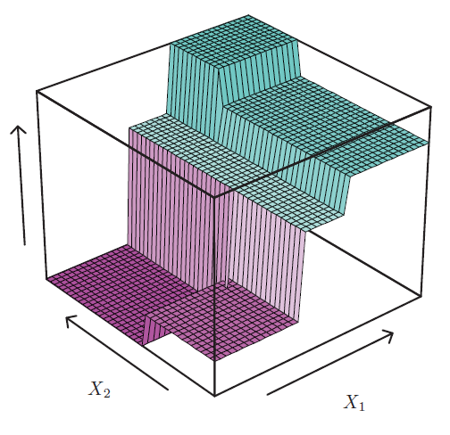
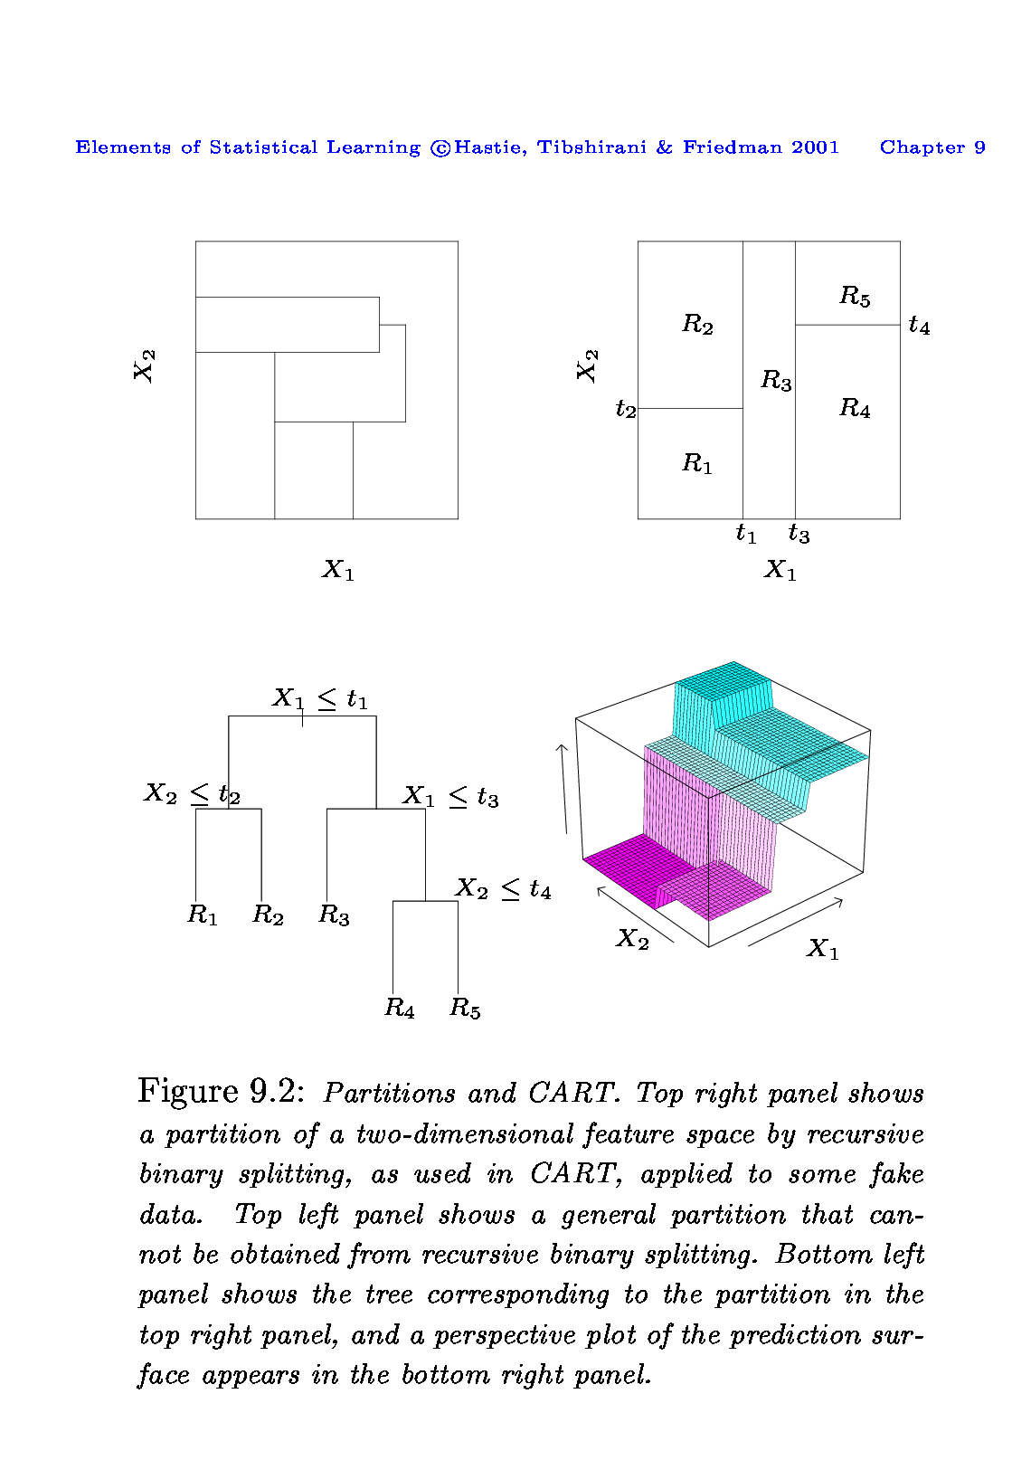
What does a decision tree do?
R₅
R₄
R₃
R₂
R₁
Converts a ML task (classification; regression) into answering a series of questions about the values of individual features
Makes predictions based on the answers to those questions

Slide 5
How do we fit a decision tree?
Descriptive (what effectively happens?):
Select a single feature and a threshold
Split the observations into 2 sub regions: those where the feature value is higher than the threshold and those lower than the threshold
Repeat this process on the subregions until satisfactory conditions are met
Methodological (How do we actually do this?)
How do we decide which feature & threshold?
How do we decide which subregion to split next?
How do we know when to stop?
Independent Worksheet Exercise to answer these questions (5 minutes)

Slide 6
Performance Trees vs. Linear Model: Data Linearity & Alignment
Top row: the true decision boundary is linear (but not aligned)
Left: linear model (better)
Right: decision tree (worse)
Bottom row: the true decision boundary is non-linear (but aligned)
Left: linear model (worse)
Right: decision tree (better)

Slide 7
Pros and Cons of Decision Trees
Pros:
Trees are very easy to interpret (probably even easier than linear regression)
Trees can be displayed graphically, and are easily interpreted even by non-expert
Trees handle both classification and regression problems
Cons:
Trees struggle on data that doesn’t align with feature dims (Solution: transform the data)
Trees can easily overfit (Solution: Pruning)
Trees don’t have the same prediction accuracy as some of the more complicated approaches in ML

Slide 8
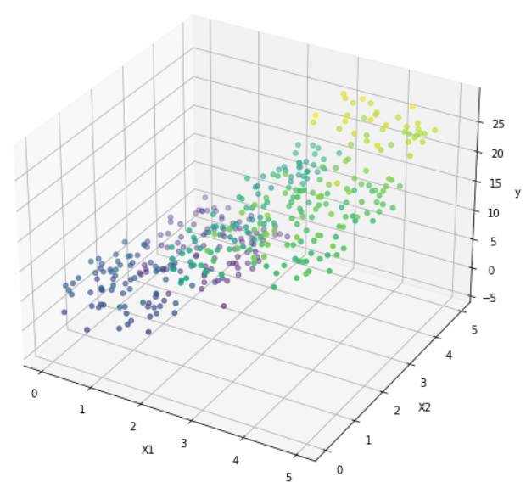
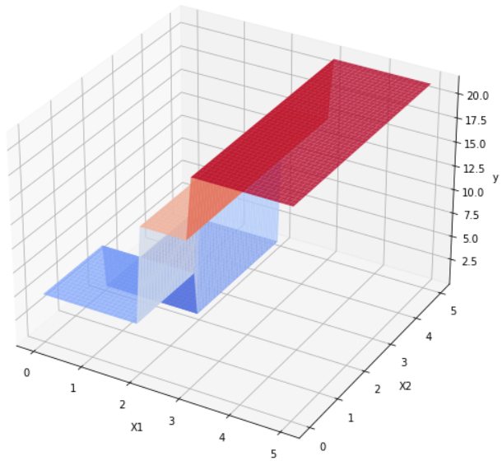
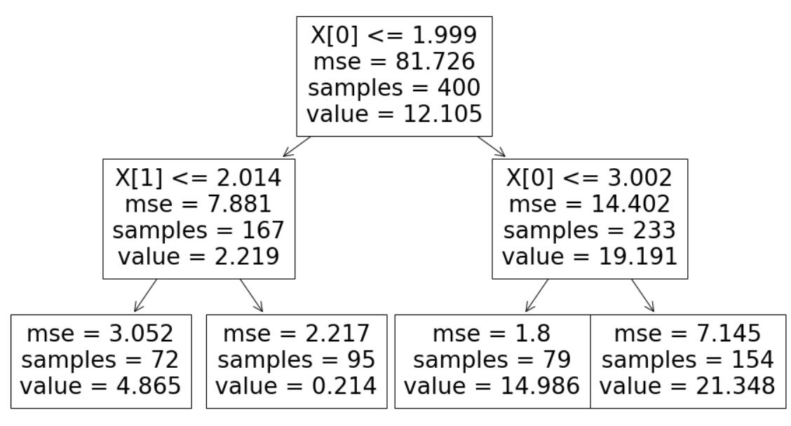
Coding Demo – Decision Trees
Obtain the code from Canvas
Instructor Overview / Description of Task
Breakout Groups to work on coding (15 min)
Share your results

Slide 9
Break

Slide 10
Questions & Open Project Discussion

